Slide 1
AI Innovation or the END of Dating?

Slide 2
A Brief (Recent) History of Relationships
1940 – 1960: The Establishment of Modern Norms
1960 – 2000: The Erosion of “Traditional” Norms
2000 – 2010: The Delay of Norms
2010 – Now: The Individualization of Society

Slide 3
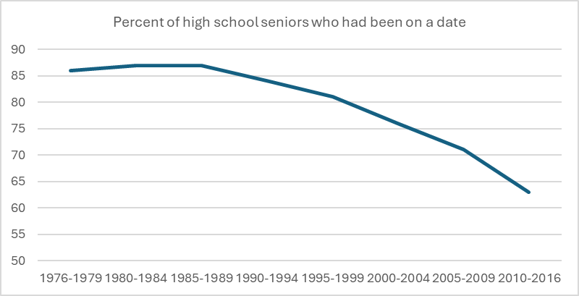
The Decline of Relationship Formation

Slide 4
Factors?
Less importance on dating/marriage
More options for free time
Pornography
More education/job anxiety
Key for today:
Digital Isolation
Digital Alternatives

Slide 8
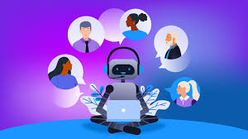
What is Unique about AI chatbots?
They mimic a naturalistic environment (UI mimics text/dating app interfaces)
They naturally seek user approval through text cues
They validate!
They are customizable!

Slide 9
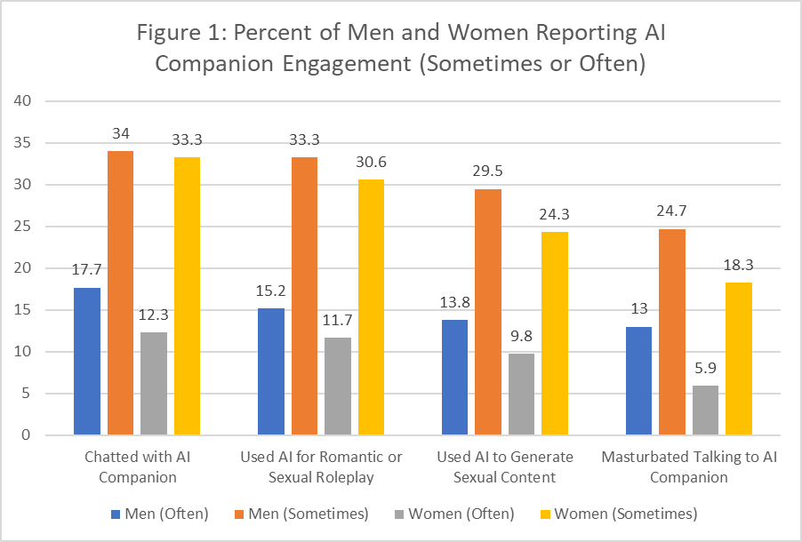

Slide 10
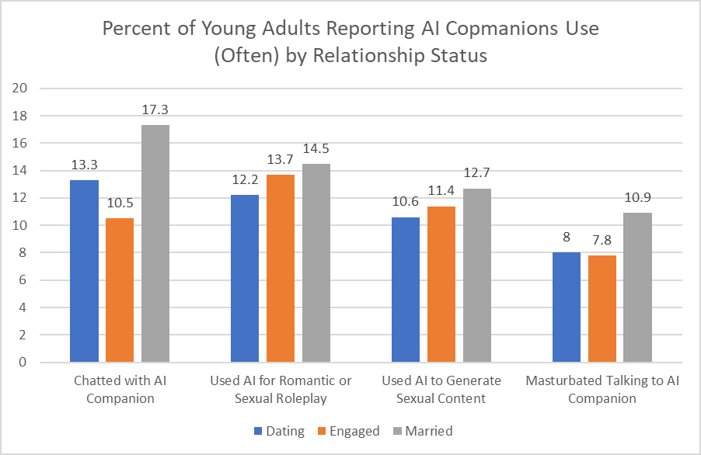

Slide 11
Attitudes?
Most people think AI is great!
63% say that AI companions are an acceptable way to feel loved and connected
53% agree that AI generated porn is more morally acceptable than normal porn
37% believe AI companions are acceptable while in a relationship

Slide 12
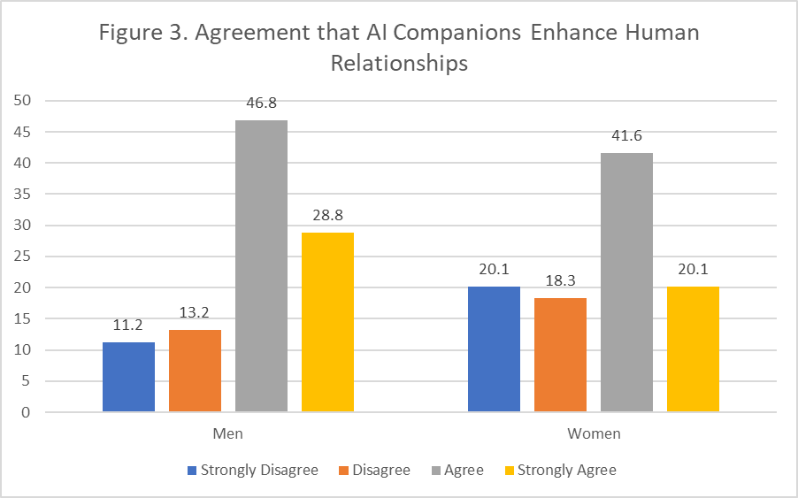

Slide 13
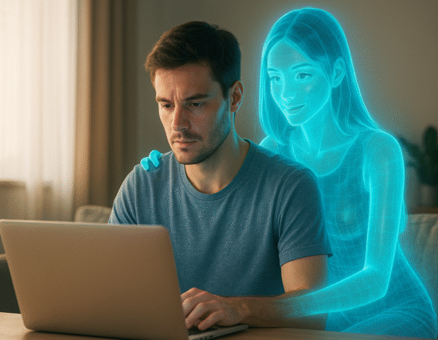
What are the Issues?
Scripting and expectations – the “Porn Problem”
Preference – the “AI problem”
Compulsive and problematic use

Slide 15
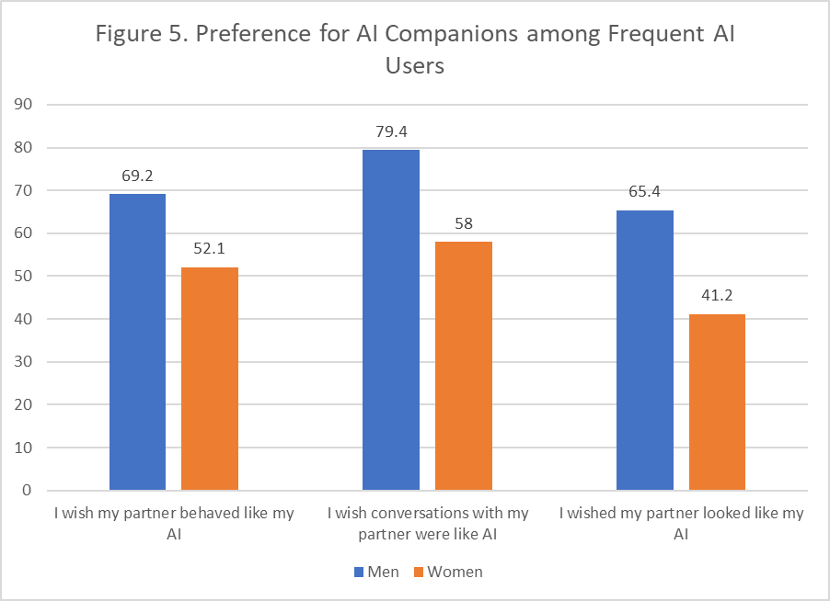

Slide 17
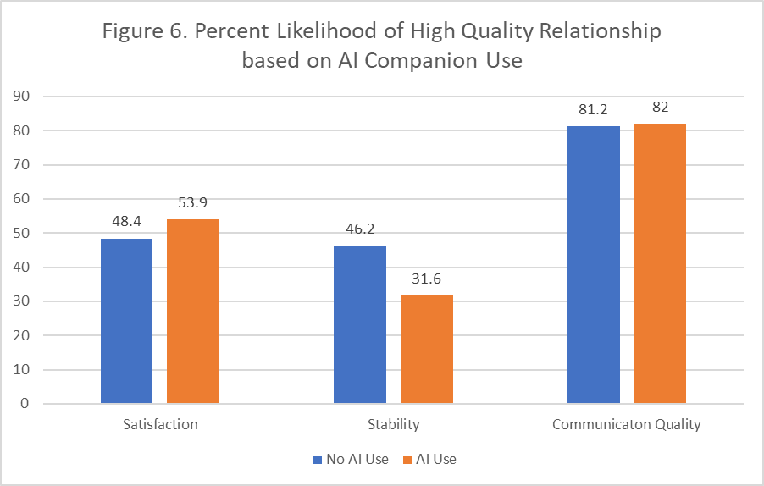

Slide 18
Questions?

